Slide 1

Exploratory Data Analysis On IPL Dataset (2008-2016)
BY :-- Chinmay Girish Paranjape

Slide 2
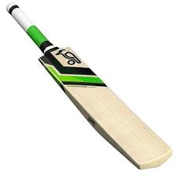
Batsman Analysis
Top Run Scorers
Strike Rate Of Batsman
Dot Balls By Batsman
Number Of Boundaries
Number Of Sixes
Number Of Times Player Played till 20th Over
Average Of Batsman

Slide 3
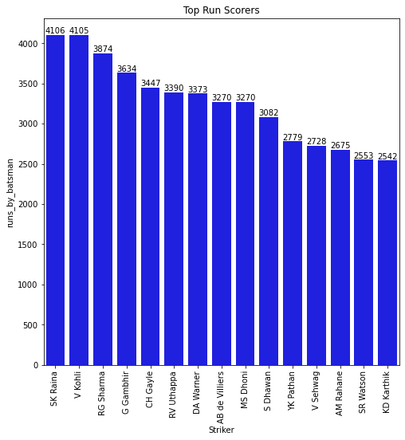
Top Run Scorers

Slide 4
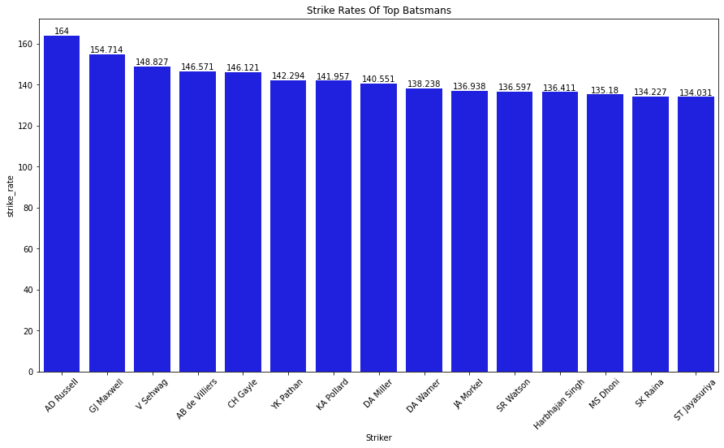
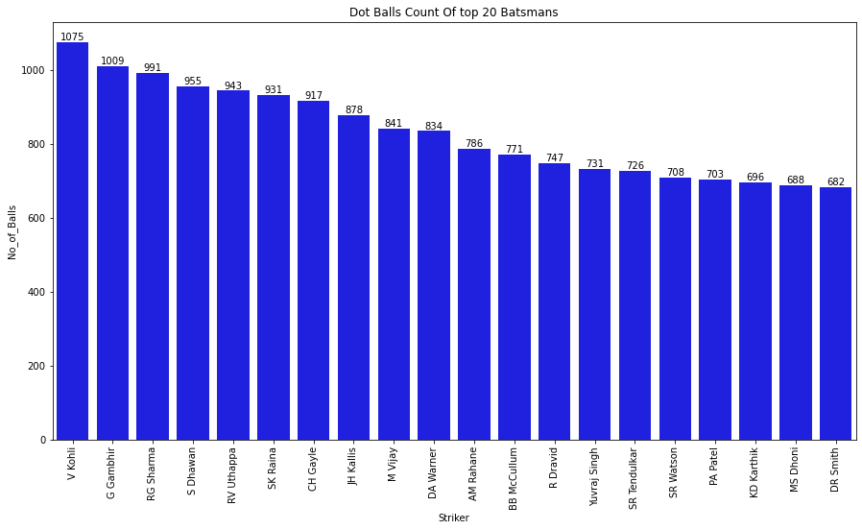
Strike Rate Of Batsman (Runs>500)
Dot Balls By Batsman

Slide 5
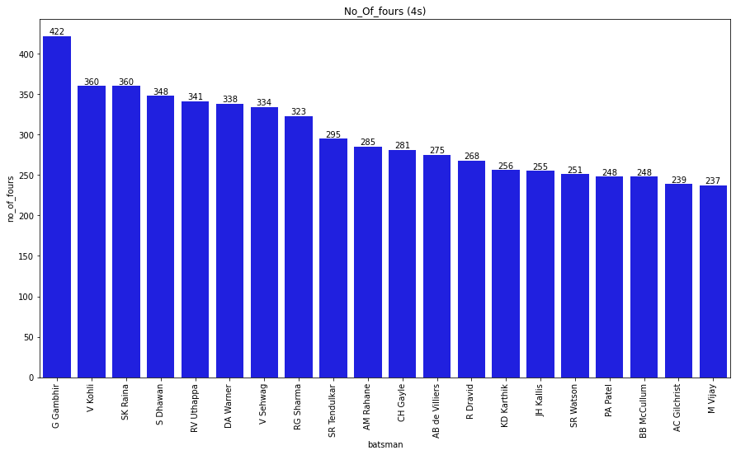
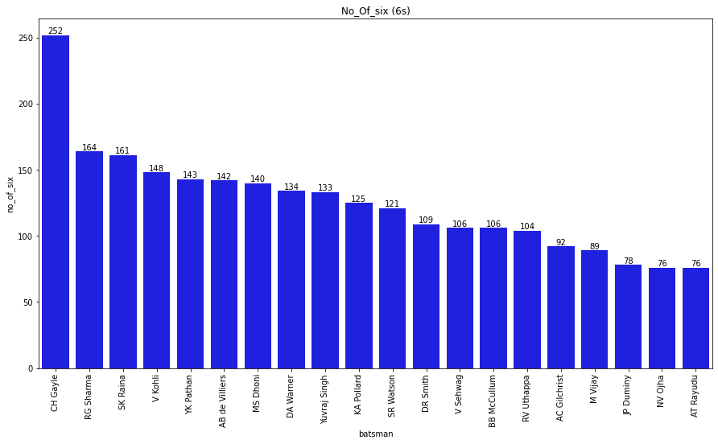
Number Of Boundaries
Number Of Sixes

Slide 6
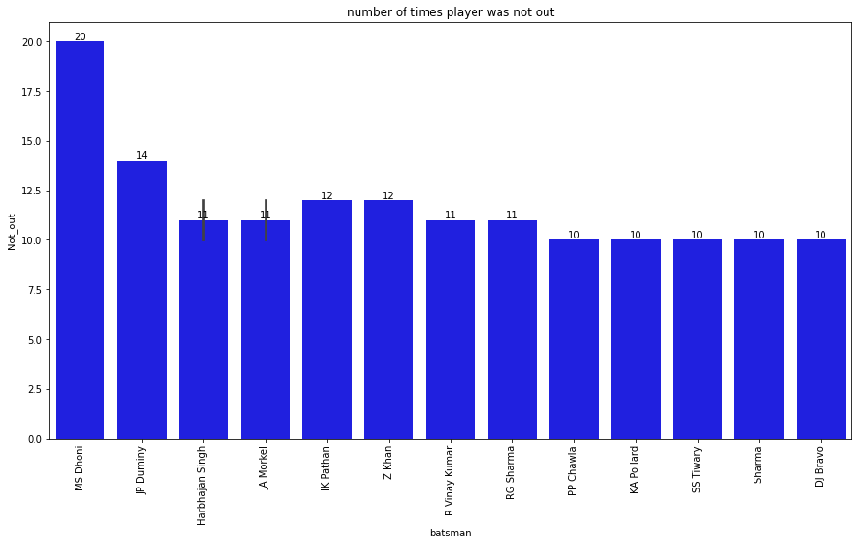
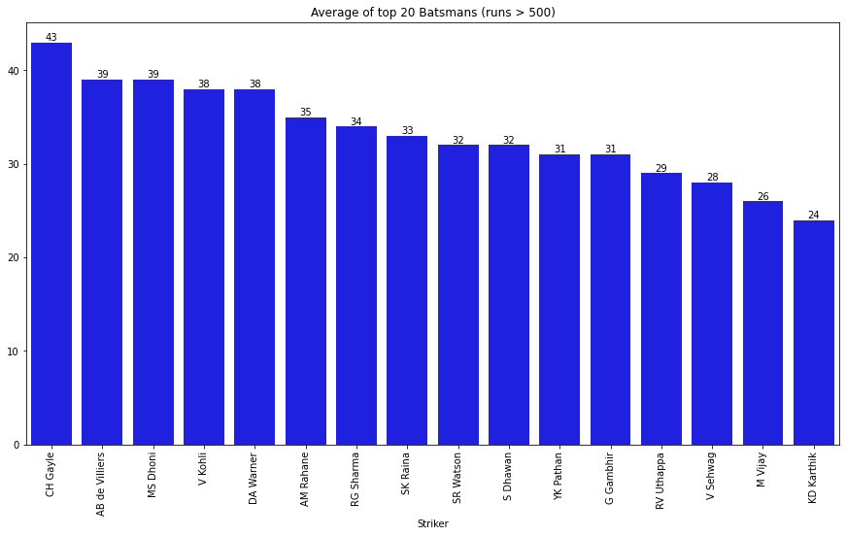
Number Of Times Player Played till 20th Over
Average Of Batsman (RUNS > 2500)

Slide 7
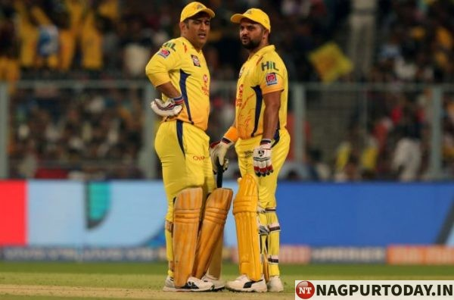
SELECTED BATSMANS FOR MY TEAM

Slide 8
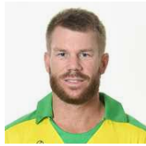
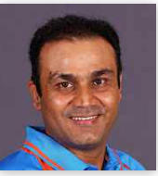
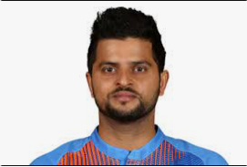
1. David Warner
(Opner- Striker)
2. Virender Sehwag
(Opner- Non-Striker)
3. Suresh Raina
(No. 3)

Slide 9
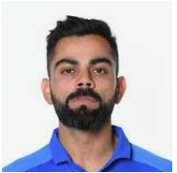
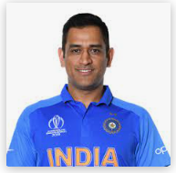
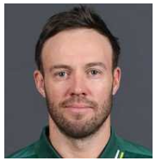
4. Virat Kohli
5. MS Dhoni
6. AB de Villiers

Slide 10
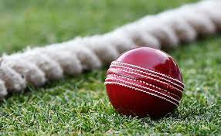
Bowlers Analysis
Wickets Taken By Bowlers
Overs Bowled By Bowlers
Dot balls by Bowlers.
Runs Given By Bowlers.
Extra Runs Given By Bowlers
Economy Of Bowlers
Strike_rate Of Bowlers (wkt/run)
Average Of Bowlers (run/wkt)

Slide 11
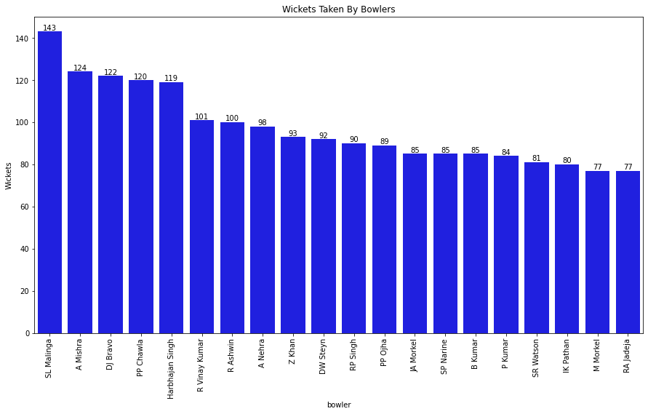
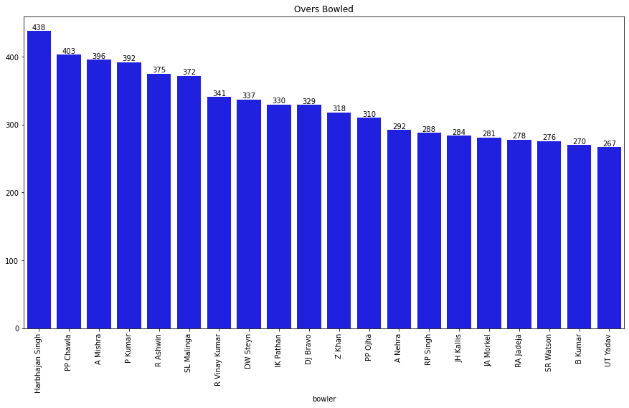
Wickets Taken By Bowlers
Overs Bowled By Bowlers

Slide 12
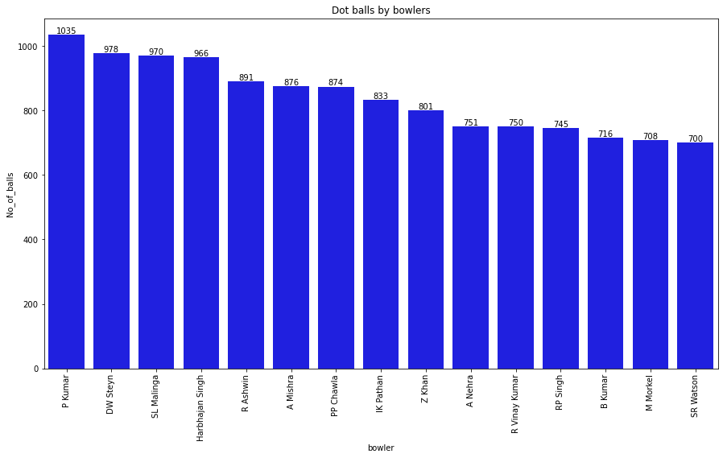
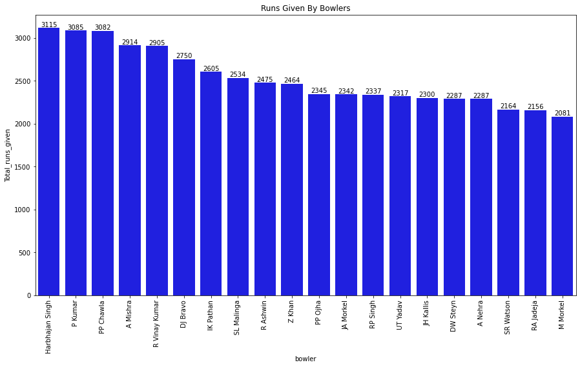
Dot balls by Bowlers.
Runs Given By Bowlers.

Slide 13
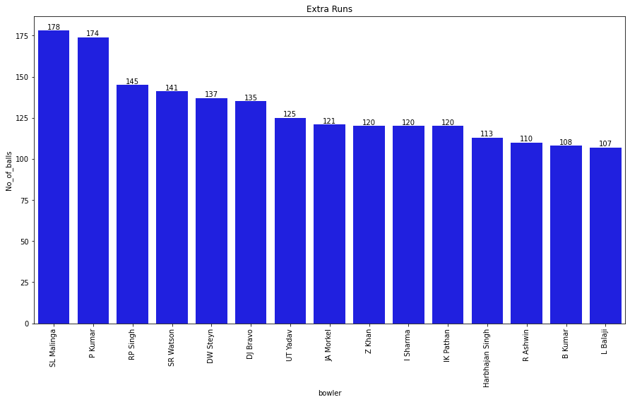
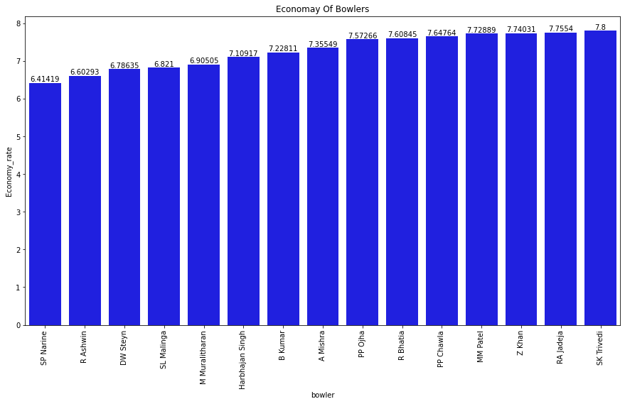
Extra Runs Given By Bowlers
Economy Of Bowlers

Slide 14
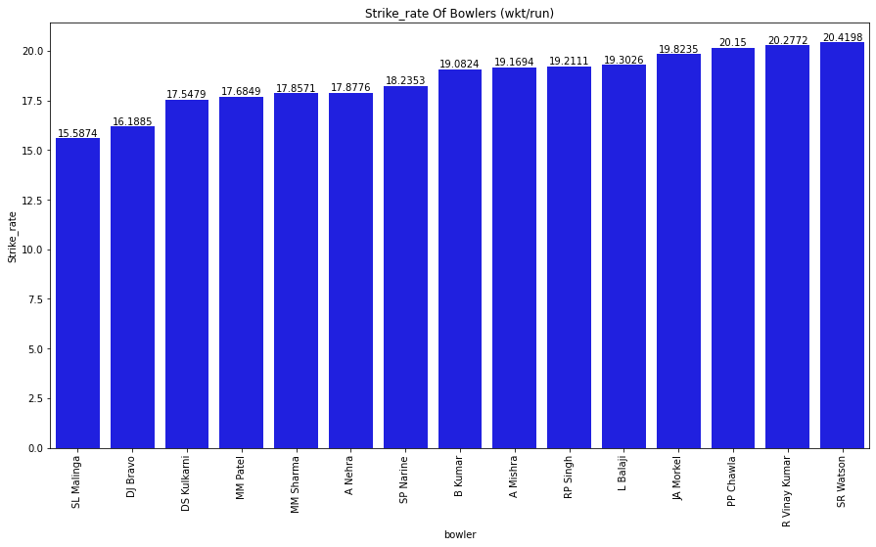
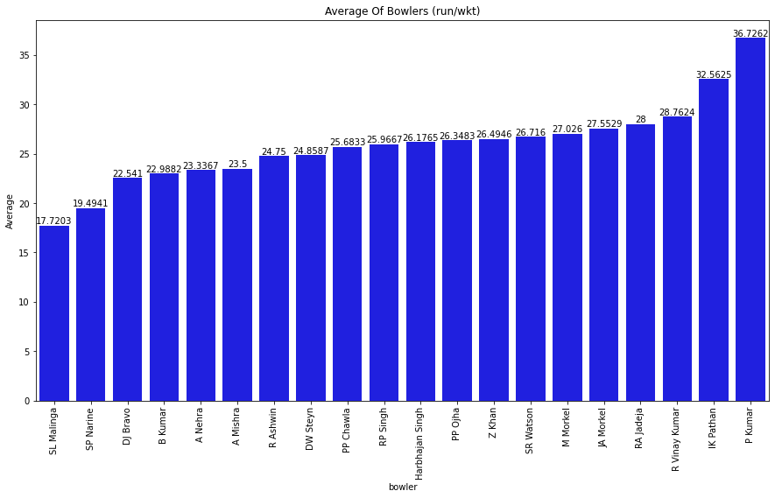
Strike-rate Of Bowlers (balls/wkt)
Average Of Bowlers (run/wkt)

Slide 15
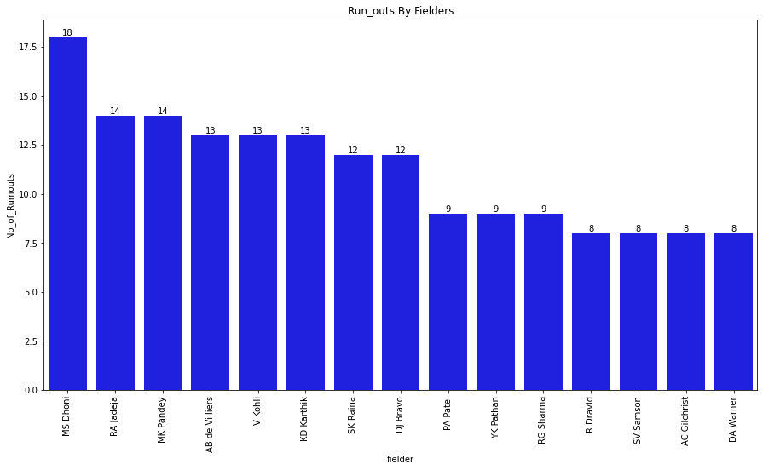
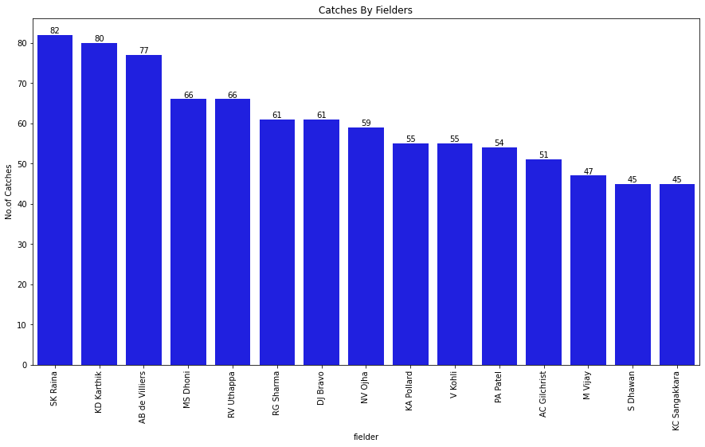
Fielder Analysis
Run-Outs By Fielders
Catches By Fielders

Slide 16
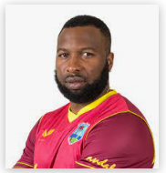
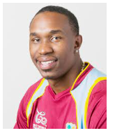
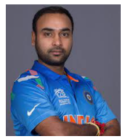
7. Kieron Pollard
8. Dwayne Bravo
9. Amit Mishra

Slide 17
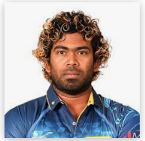
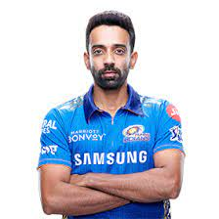
10. Lasith Malinga
11. DS Kulkarni

